Slide 1




BG6
PVN
2026 PVN FME Q1工作報告
部門: (PVN)第六事業群-製造及營運管理中心-越南製造處-PVN1廠-FME部-自動化課
姓名: Leon_Than 申玉龍
職等: 19
日期: 2026/03/18
FME
BG6 PVN

Slide 2
BG6
PVN
2026 - Q1 Work Results
Time | Work Results
2025 Q4 | 1. Continue complete unfinished AOI Projects at F5-4F of Q3-2025.
 | 2. Complete new AOI External projects at F5-4F. Improve missing component issue.
 | 3. Add new function, optimize working time for all AOI External stations at F5-4F.
 | 4. Setup station and build up program for AOI External stations at F5-5F.
2026 Q1 | 5. Add new function, prevent OP make incorrect actions and arrange products not according to SOP at Station K10-AOI Carton Machine of 4K-Panasonic
 | 6. Build up and testing new program for the AOI Carton for Yamaha series in line 4K.
 | 7. Build up and testing new program for the AOI Giftbox for Yamaha series in line 4K.
 | 8. Manage and organize human resources of Software and Vision Team. Ensure production and customer requirements. Meet automation needs.
 | 9. Continue perform plans and goals for the F5-5F AOI External Station.
FME
BG6 PVN

Slide 3
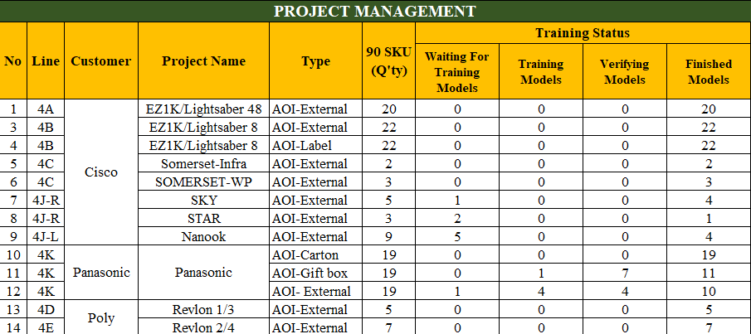
BG6
PVN
Detailed description of work results
1. Continue complete unfinished AOI Projects at F5-4F of Q3 - 2025.
Project :
AOI External Star ( 4J Line )
AOI External Nanook ( 4J Line )
AOI External Revlon 1/3 ( 4D Line )
AOI External Revlon 2/4 ( 4E Line )
AOI External Panasonic ( 4K Line )
AOI Carton ( 4K Line )
AOI Giftbox ( 4K Line )
Progress :
Complete 1/3 model of AOI External Star
Complete 4/9 model of AOI External Nanook
100% completion with AOI External Revlon 1/3
100% completion with AOI External Revlon 2/4
Completed 6/13 – Verify 6/13 of AOI External Panasonic
100% completion with AOI Carton
Complete 10/13 model of AOI Giftbox
Quanlity
Ensured defect detection accuracy and stable inspection results.

Slide 4
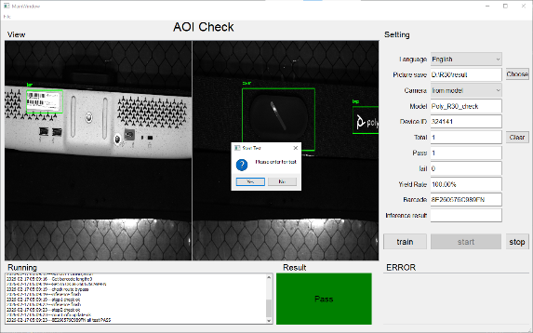
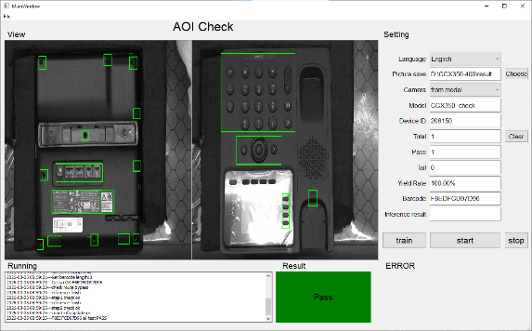
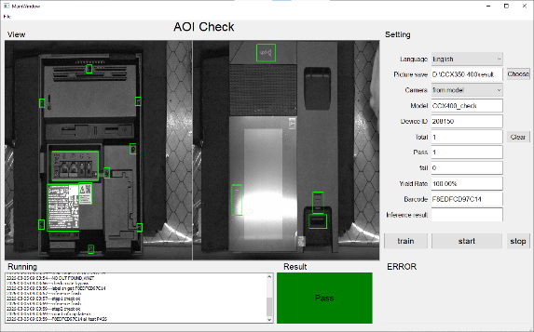
BG6
PVN
Detailed description of work results
2. Complete new AOI External projects at F5-4F. Improve missing component issue.
Project :
AOI External R30 ( 4N Line )
AOI External CCX350 ( 4P Line )
AOI External CCX400 ( 4P Line )
Progress :
100% completion with AOI External R30
100% completion with AOI External CCX350
100% completion with AOI External CCX400
Quanlity
Total: 14 models across 3 projects
Completed: 100%
Outcome
Improved detection of missing components across all AOI External project
Enhanced product quality and reduce false detection.
R30
CCX350
CCX400

Slide 5
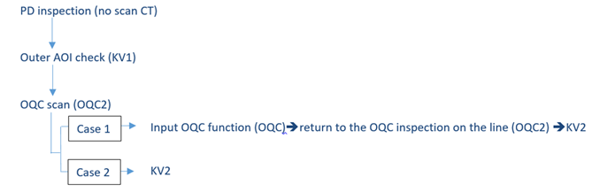
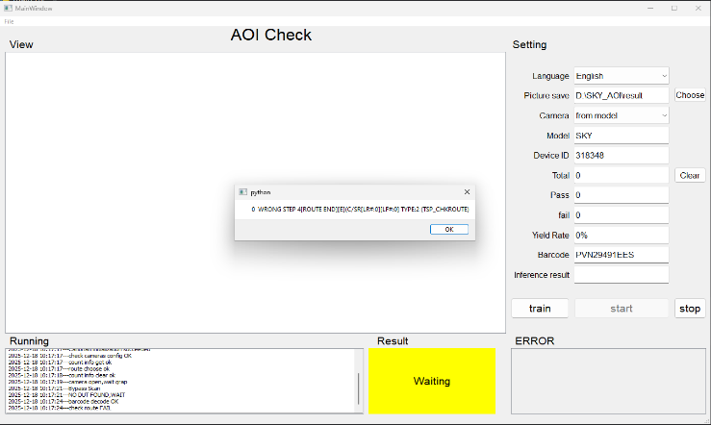
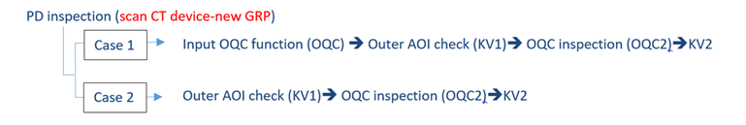
BG6
PVN
Detailed description of work results
3. Add new function, optimize working time for all AOI External stations at F5-4F.
Location: Station AOI F5 – 4F
Improvement: Improve station AOI
Before Improve
During production: The operator (OP) cannot know which product is at the station, leading to the need for multiple appearance inspections.
Details Improve
Program:
Add more function to check the status of product => Make sure all units are correct in their station
When the unit without the correct station => Display a warning screen in the program.
Station AOI before improve
After Improve
Station AOI after improve
The number of appearance inspections has decreased. Optimize time for PD
Make sure all units without the correct station will be re-checked at that correct station

Slide 6
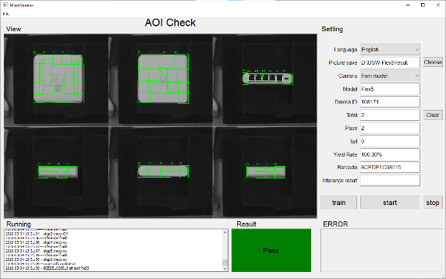
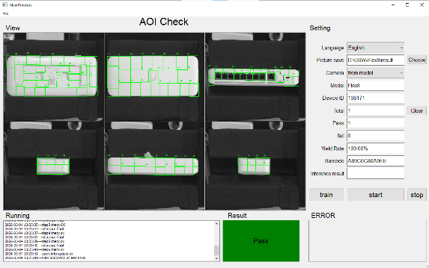
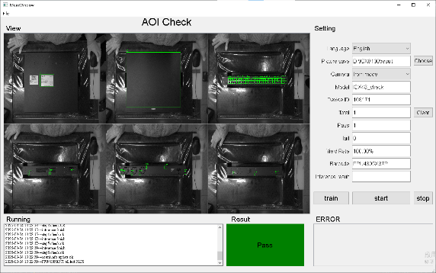
BG6
PVN
Detailed description of work results
4. Setup station and build up program for AOI External stations at F5-5F.
Project :
AOI External USW-Flex-2.5G-8 / POE ( 5P Line )
AOI External USW-Flex-2.5G-5 ( 5P Line )
AOI External ICX-8100 series ( 5S Line )
Progress :
100% completion with AOI External USW-Flex-2.5G-8 / POE
100% completion with AOI External USW-Flex-2.5G-5
AOI External ICX-8100 series in the process of verify the models
Quanlity
Total: 2/3 projects finished
Completed: 67%
Outcome
Improved detection of missing components across all AOI External project
Enhanced product quality and reduce false detection.
USW-Flex-2.5G-8/POE
USW-Flex-2.5G-5
ICX-8100

Slide 7
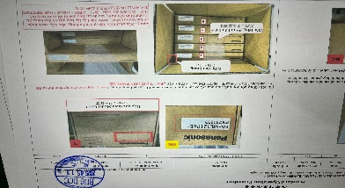
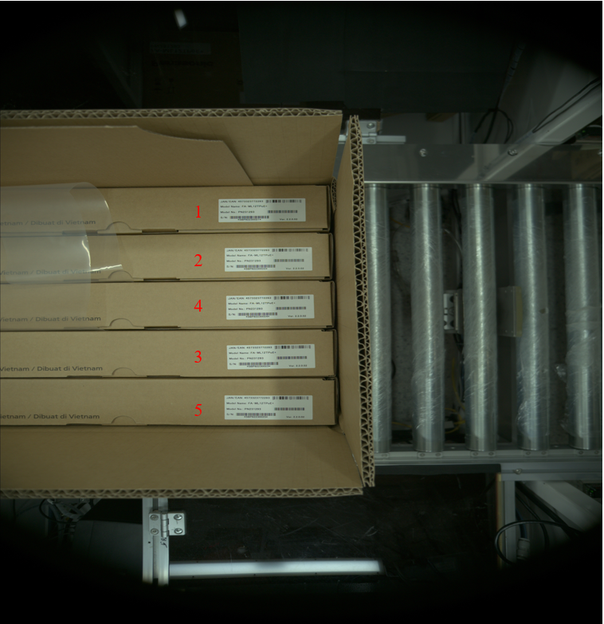
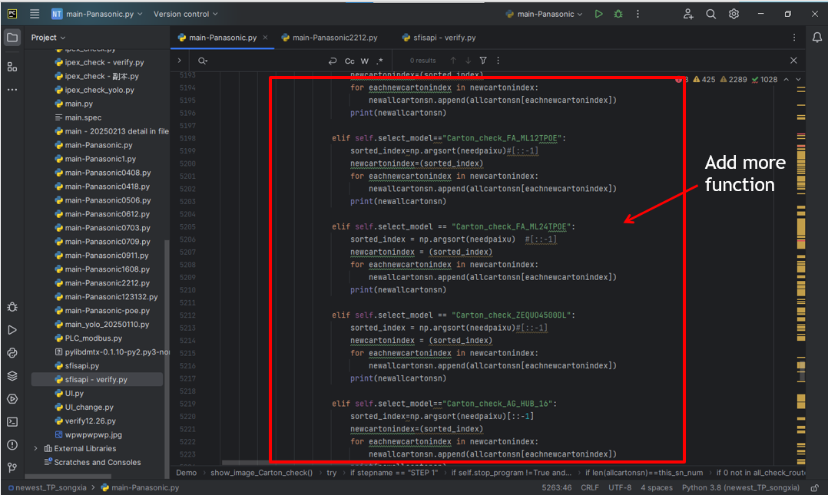
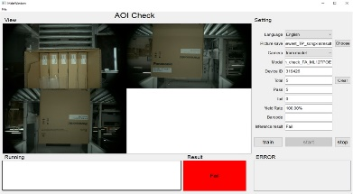
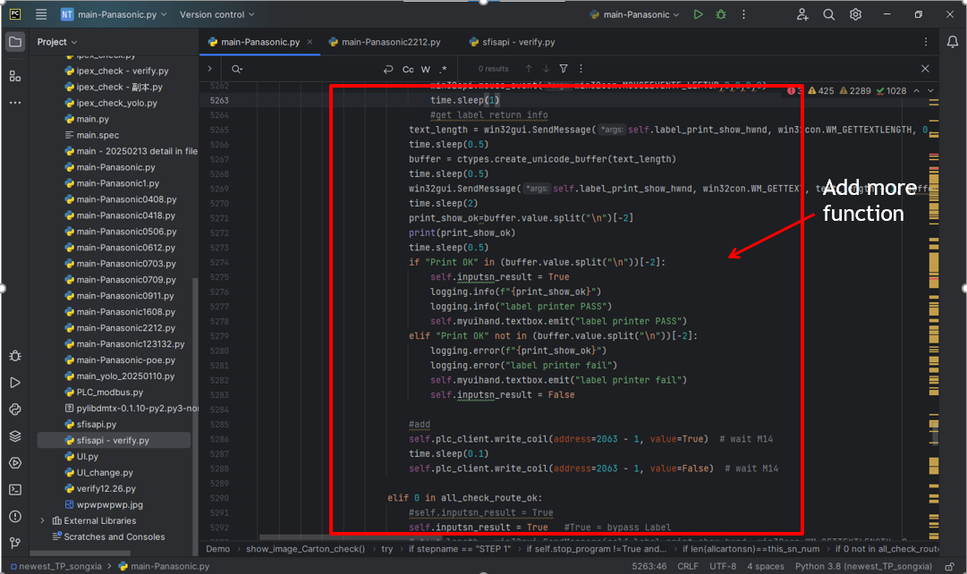
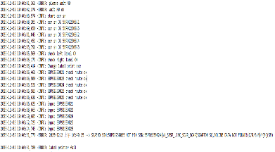
BG6
PVN
Detailed description of work results
5. Add new function for AOI Carton Machine of 4K-Panasonic
Location: 4K – Panasonic – Station AOI Carton
Model: Panasonic
Improvement: Improve station AOI Carton
Before Improve
During production: The Operator (OP) may make incorrect actions and arrange products not according to SOP
This leads to failure in ensuring the quality and accuracy of the carton packaging process.
Details Improve
Program Improvement :
Added a camera function to check the product status and ensure all units are correctly arranged inside the carton.
If the unit is not placed at the correct position => The program fails and carton printing is disabled.
PLC Improvement :
Integrated PLC checking to verify the product quantity and correctness.
When the operator arrange product incorrect => The program fails => Red warning light and alarm signal are activated
Station P6 (Carton Label) before improve
After Improve
The AOI system automatically verify carton arrangement before printing label.
Incorrect cartons are detected immediately and prevented from entering the next process
Operator dependency is reduced, ensuring consistent packaging quality
Station P6 (Carton Label) after improve

Slide 8
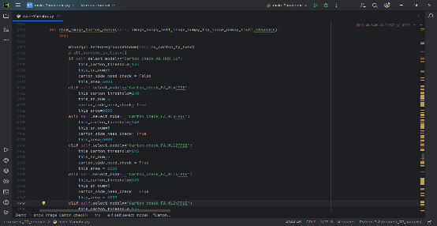
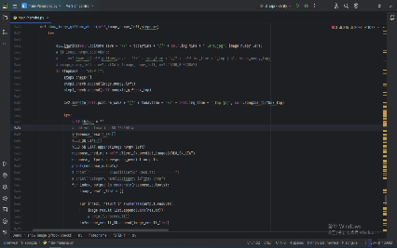


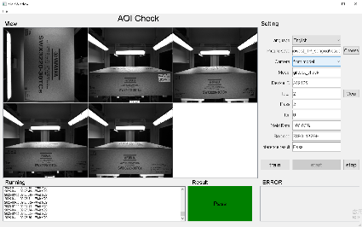
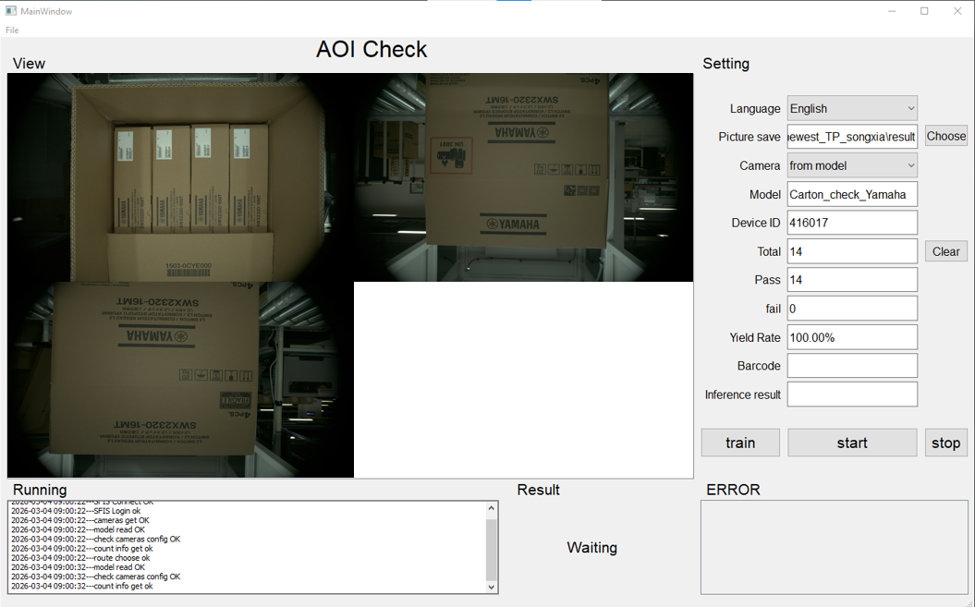
BG6
PVN
Detailed description of work results
6-7. Build up and testing new program for the AOI Carton/AOI Giftbox for Yamaha series in line 4K.
Location: 4K – Yamaha – Station AOI Carton/ AOI Giftbox
Model: Yamaha/Zumba
AOI Carton Yamaha/Zumba
Completed development of the AOI Carton program for the Yamaha series.
Completed connection with Label Printing Software ang Weighing Software from MIS.
Completed reading and verification label code on each product inside the carton.
The automation process is not yet fully completed.
AOI Giftbox Yamaha/Zumba
Completed development of the AOI Giftbox program for the Yamaha/Zumba series.
Completed reading and verification of the label code on the giftbox.
The product appearance inspection process is still in the training phase.
Label Printing Software
Weighing Software

Slide 9
BG6
PVN
Q1 Work and Self-Development Plan Achievement Rate
Q3 Work and self-development plan | Achievement rate | The reason | The plan for completion
1. Improve communication skills in Chinese | 35% | Not really focused on learning Chinese | Try to learn to listen and speak more realistically.
2. Expanding understanding in relevant areas : robot, plc, . | 50% | Solving basic problems, some of advanced problems still need to improve | Learn and exchange more with Tom_Vu and Max_Doan about advanced optimization.
3. Optimize python code for program | 90%
4. Improve problem solving skills | 60% | Lack of experience and initiative in solving new problems | Take the initiative to learn and exchange problem-solving methods from experienced colleagues such as: Mr.Albert ,Tom_Vu, PSZ_Snow,...
FME
BG6 PVN

Slide 10
BG6
PVN
Q1 Work and Self-Development Plan
Time | Work and Self-Development Plan
2026 Q1~ | Continue to improve Chinese skills
 | Continue to improve robot and PLC problem solving skills
 | Improve problem solving skills
 | Improve programming skills
FME
BG6 PVN

Slide 11
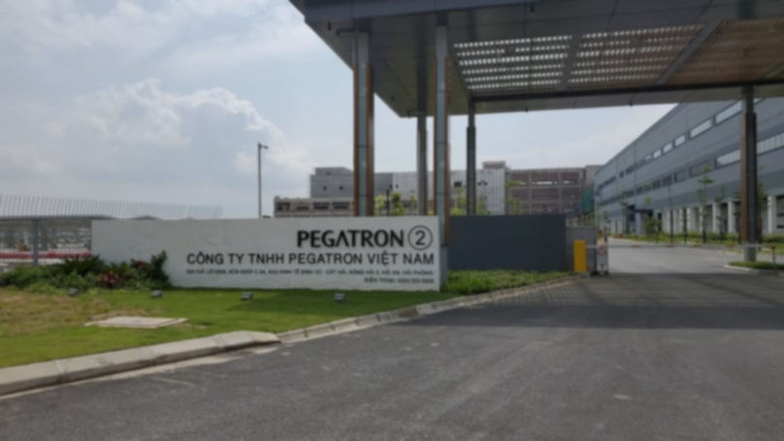
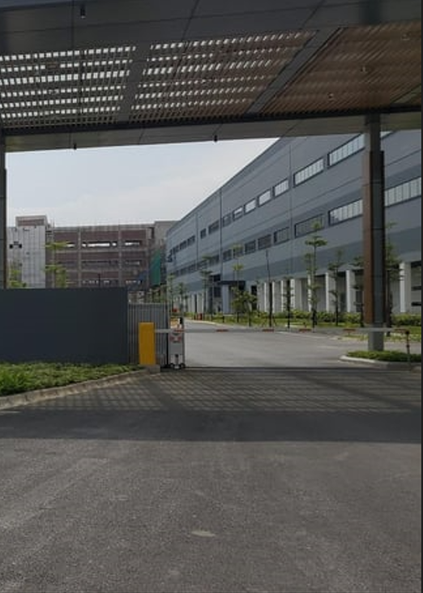
Thank You

